Slide 1
Networks and Infrastructure Resilience
Alesia Chernikova, Northeastern University
April 2024

Slide 2
Motivation
Cyberattacks in cyber networks are multifaceted, constantly improving, becoming much more dangerous.
The number of victim organizations and individuals has been growing significantly, causing massive damage worldwide, such as financial losses, data leakage, and disruption of essential services.
Existing countermeasures and solutions often fail in the face of advanced adversaries.

Slide 3

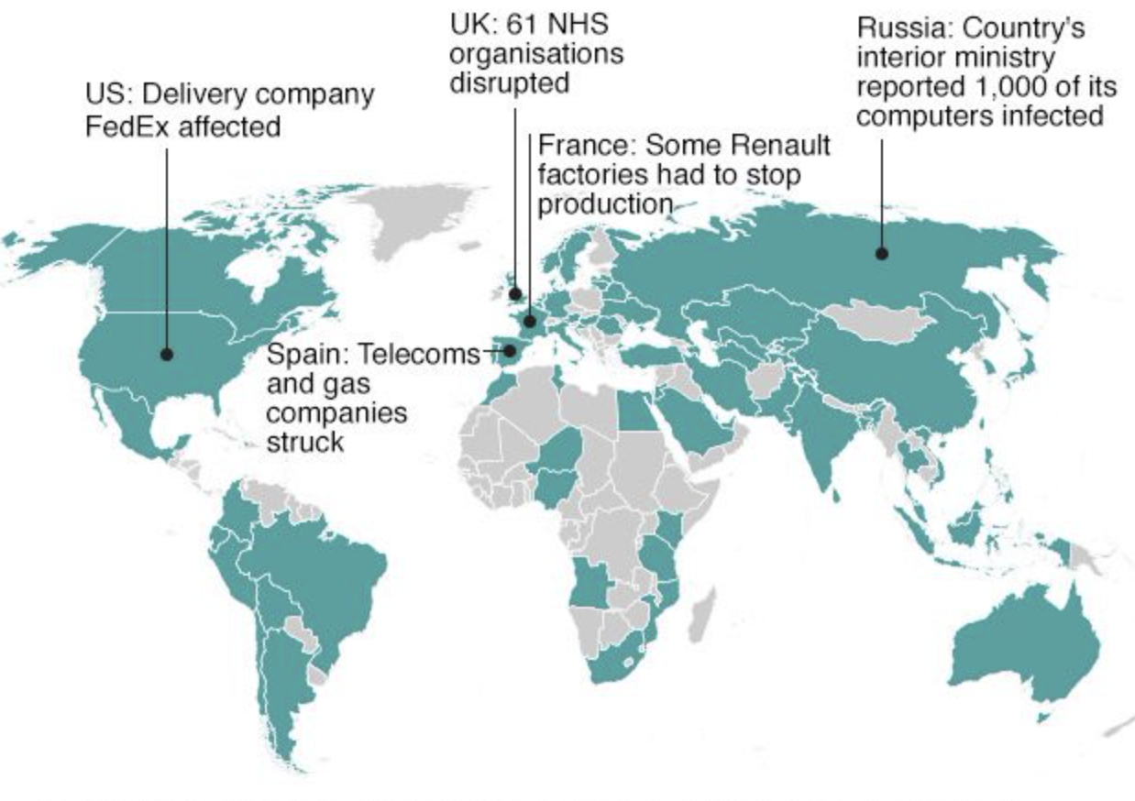
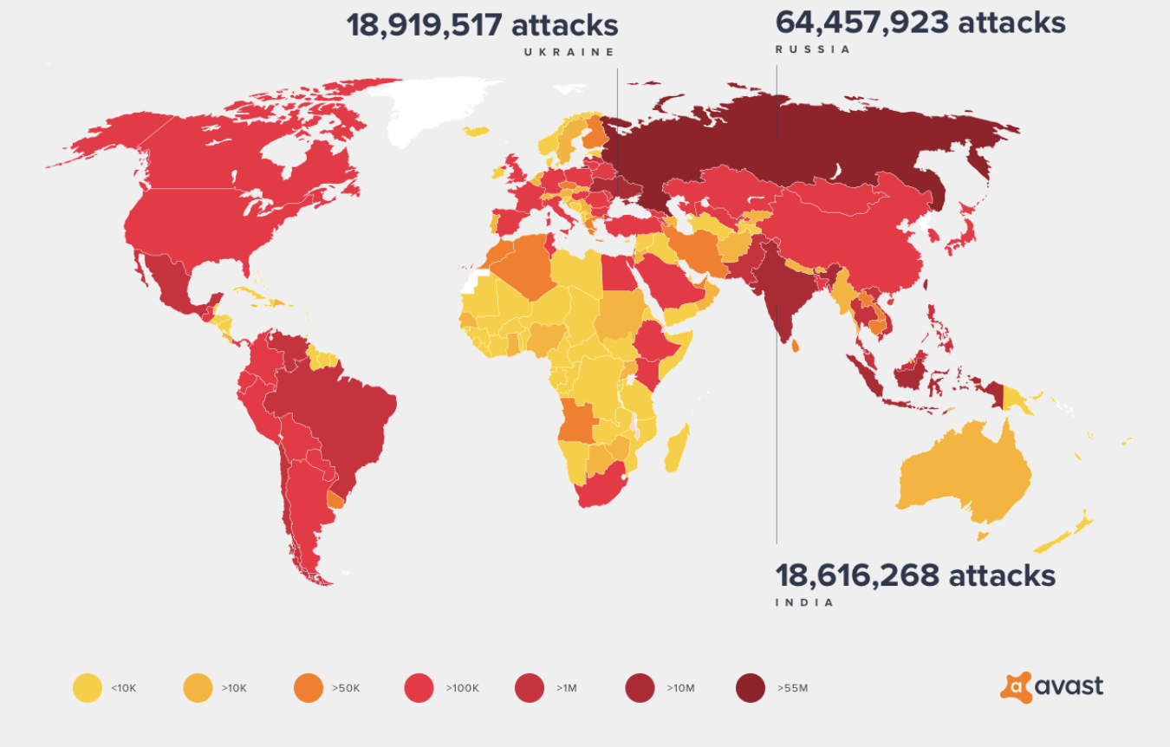
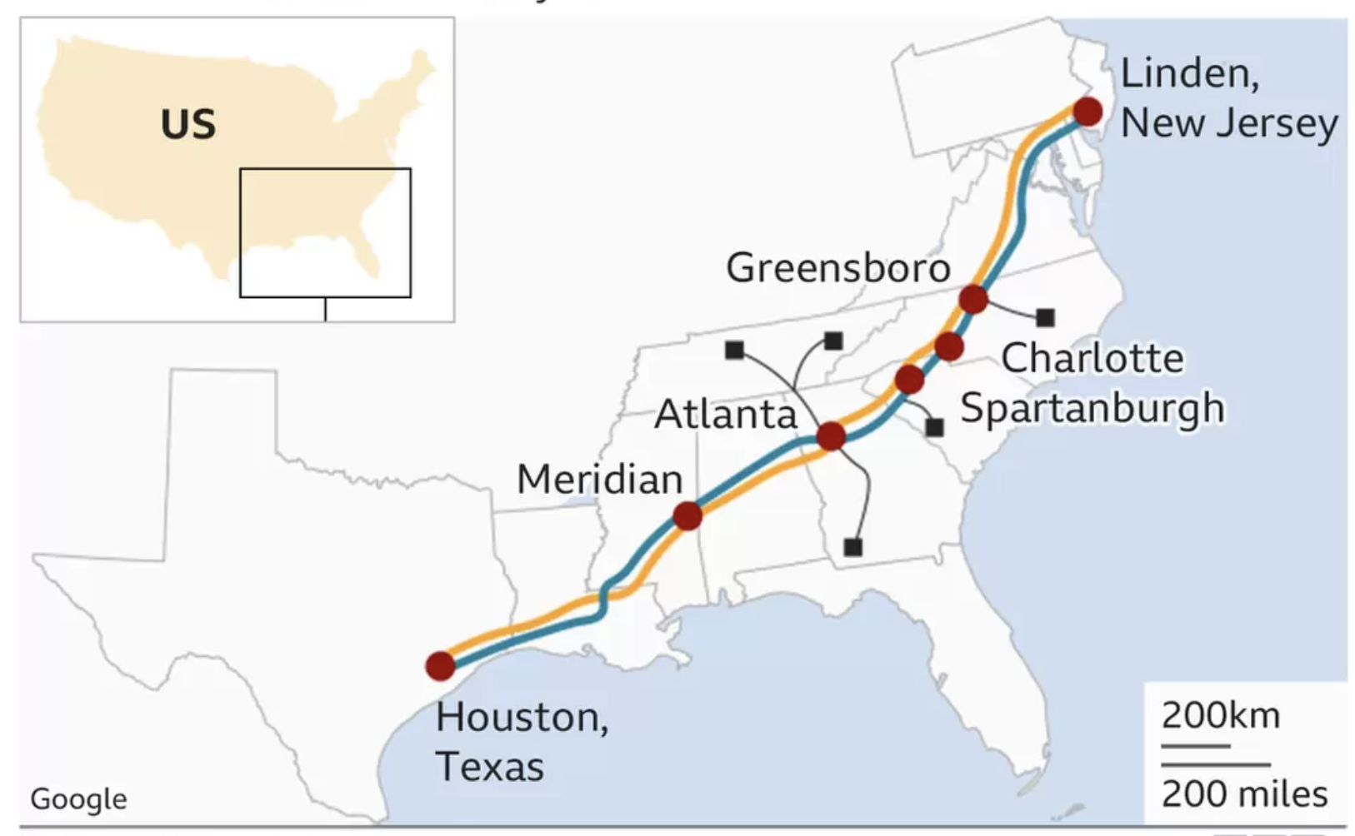
Cyber attacks
Cyber attacks include self-propagating malware (SPM), distributed denial-of-service (DDoS), advanced persistent threat (APT), and many others.
SPM propagates within and across networks, exploiting vulnerabilities of network services.
Enterprises affected by WannaCry
Number of attacks May 2017 - April 2018
Colonial Pipeline System
Notes:
For instance, WannaCry and Mirai SPM infected hundreds of thousands of machines on the Internet.
SPM infected Colonial Pipeline digital systems evolving in a prolonged shutdown that affected consumers and airlines in the United States and resulted in a state of emergency declaration. NotPetya malware brought more than 10 billion dollars in damages.

Slide 4
Limitation of Existing Solutions
Existing defense solutions include firewalls, network intrusion detection systems, anti-virus software and many others.
Continuously evolving cyber threats may evade the existing defense solutions.
Protective mechanisms may appear infeasible to implement because of the possibility of disruption of cyber networks functionality.

Slide 5
Problem Statement
Increase the resilience of networks against cyber attacks by understanding the attacks behavior and
proposing new defense mechanisms.

Slide 6
Contributions
SPM attack modeling: A new compartmental model of epidemiology (SIIDR) to capture the behavior of real-world SPM.
Network proactive defense measures: Novel proactive defense algorithms to increase the networks’ resilience against SPM and performance evaluation on real-world large enterprise communication networks against realistic SPM attacks.
Notes:
SPM attack modeling: a new compartmental model of epidemiology called SIIDR to capturing the behavior of real-world WannaCry malware.
We derive its essential characteristics and estimate the model’s transition rates
Network vulnerability analyses: We specify the vulnerability measure of the network represented as arbitrary graph against SPM and derive the conditions when the SPM cannot result in an epidemic to inspire the choice of defense strategies.
Network proactive defense measures: We propose novel proactive defense algorithms to increase the networks’ resilience against SPM and evaluate their performance and the success rate of existing protection mechanisms on real-world large enterprise communication networks.
Robustness of ML security measures: We study the robustness of ML techniques for prediction of malicious or benign activity in the networks by developing the framework for mounting evasion attacks against ML models feasible in the cybersecurity constrained environment.

Slide 7
Modeling SPM with Compartmental Models of Epidemiology
Paper:“Modeling Self-Propagating Malware with Epidemiological Models”
link: https://link.springer.com/article/10.1007/s41109-023-00578-z
Applied Network Science (ANS) journal
Notes:
currently we are preparing the submission

Slide 8
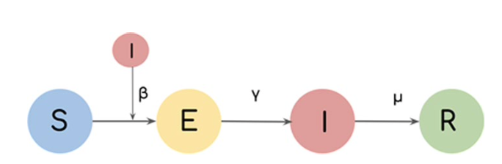
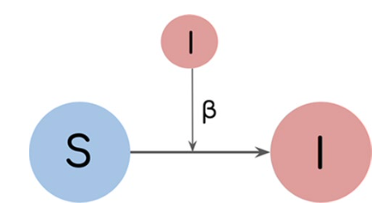
Motivation and Related Works
Modelling is performed based on the idea of similarly to epidemic spreading in complex network systems with the help of compartmental models of epidemiology.
This approach segments the population into compartments associated with various stages of infection such as S(Susceptible), I(Infected), etc., individuals can transition at specific rates among compartments.
The majority of existing works perform only theoretical analyses without fitting to real-world malware scenarios or leverage simplistic model such as SI[Wong et al., 2004] or SIR[Levy et al., 2020].
SI model
SEIR model

Slide 9
Threat Model
Cyber networks are modeled as a communication graph.
SPM compromises an initial victim machine on the network and spreads to other vulnerable machines over a specific protocol.
Modeling based on network logs collected by running actual WannaCry attacks in the monitored subnet.
Assumption that the monitored network logs are not compromised by the attacker.
t = 2
t = 3
t = 1
t = 4

Slide 10
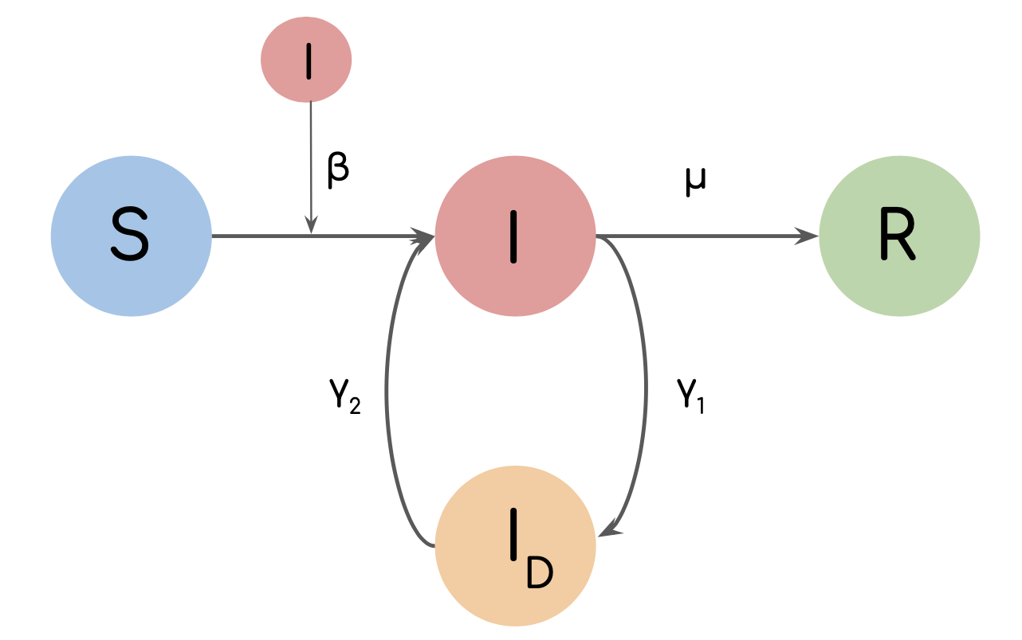
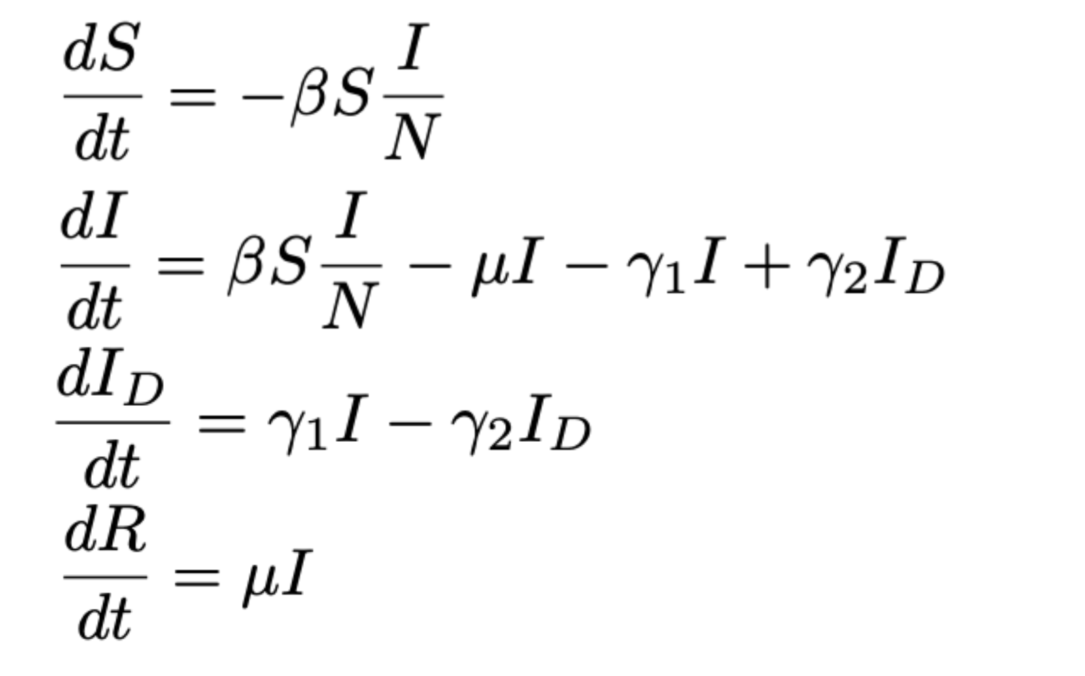
SIIDR Model
Heterogeneous distribution of intervals between subsequent attacks -> introduction of Infected Dormant (ID) state.
Intervals between last attack and the end of epidemic are large -> Recovered (R) state is the last possible state.
𝛃 = infection rate
𝛍 = recovery rate
𝛄1 = transition rate from an infected state to a dormant state
𝛄2 = transition rate from a dormant state to an infected state
Transition diagram of one node at time t.
SIIDR as a system of ODEs.
SIIDR: Susceptible - Infected - Infected Dormant - Recovered

Slide 11
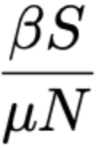
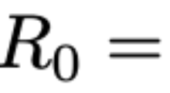
SIIDR Characteristics
Definition 1: The Basic Reproduction Number shows the number of secondary cases generated by a single infectious seed in a fully susceptible population:
Definition 2: Equilibrium point is the solution of the ODEs system that does not change with time:
Disease-free DFE = (N - R, 0, 0, R), start of the epidemic DFE*≈(S, 0, 0, 0).
No Endemic Equilibrium Points - all nodes will eventually recover.

Slide 12
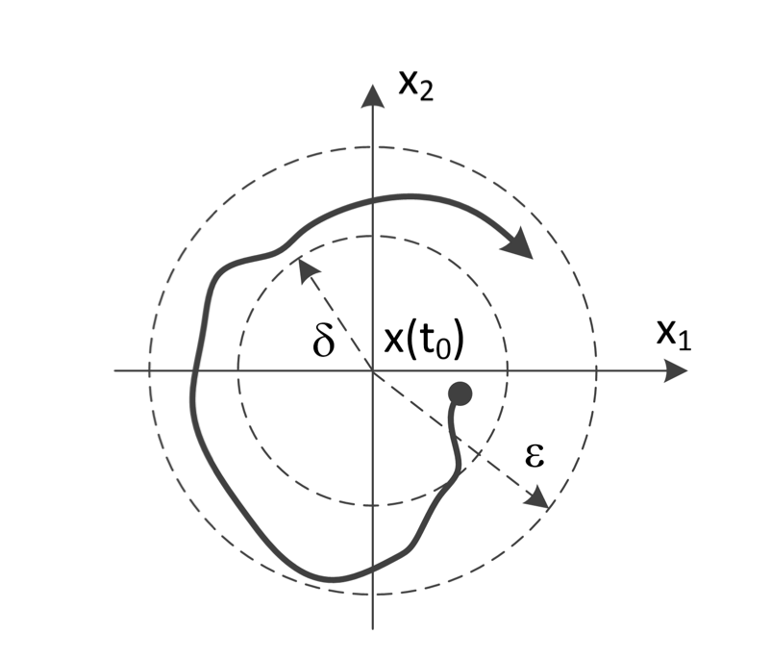
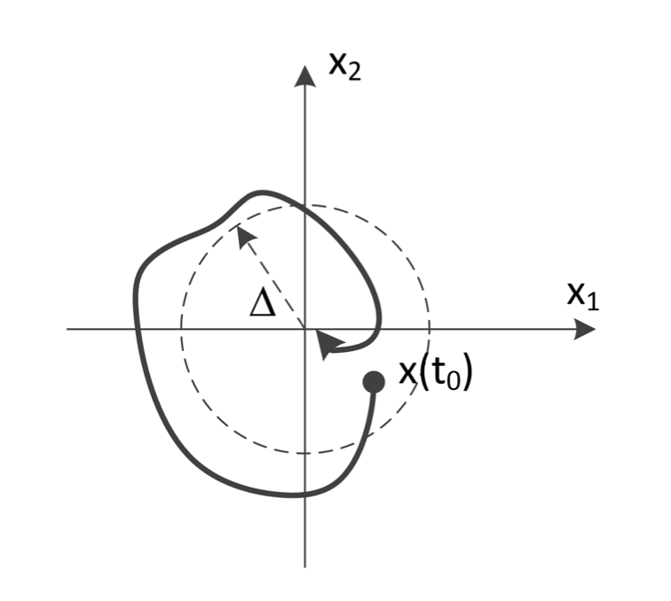
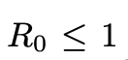
SIIDR Stability Analyses
How far the system will go if it starts near DFE?
Definition 3 : The equilibrium point E* is stable in the sense of Lyapunov: for any ε > 0, there exists a δ > 0 such that: if the system's initial state x(t₀) lies in the ball of radius δ around E*, then solutions x(t) exist for all t > 0,and they stay in the ball of radius ε around E*.
Definition 4: The equilibrium point E* is locally asymptotically stable: It is stable and the solutions x(t) with initial state x(t₀)in the ball of radius Δ converge to E* as t -> ∞.
Theorem 1: DFE points of SIIDR modeled as the system of ODEs are Lyapunov stable if .

Slide 13
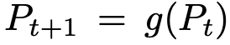
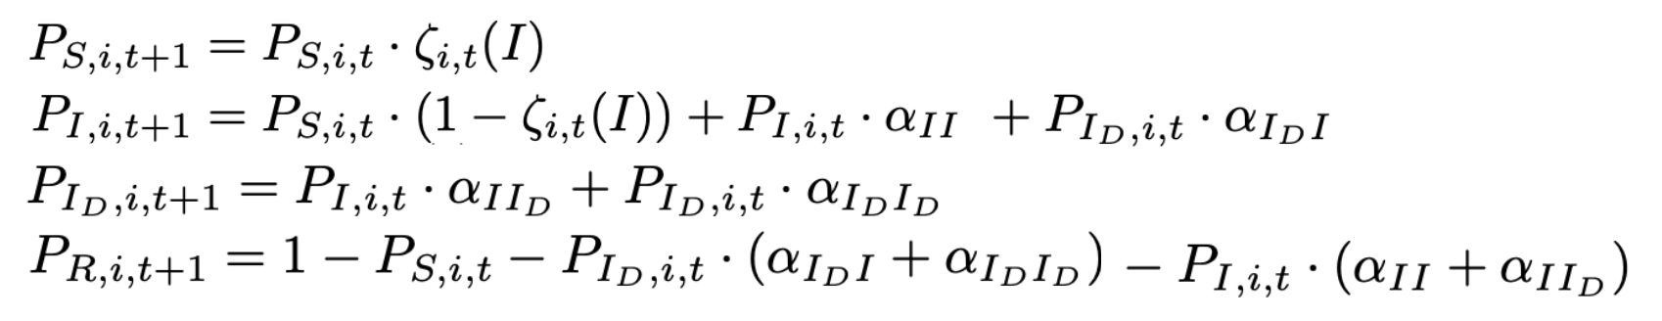
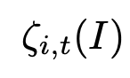
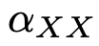
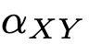
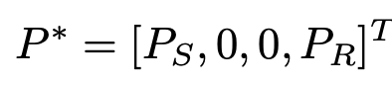
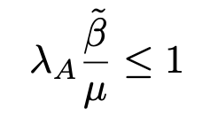
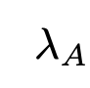


SIIDR Analyses on Arbitrary Graphs
SIIDR is represented as Non-Linear Dynamical System (NLDS) with discrete time or:
Disease-free Equilibrium Points (DFEs): .
.
probability of node not becoming infectious
probability of node to remain in state X
probability of node to transfer to state Y from state X
Theorem 2: DFEs of SIIDR as NLDS are Lyapunov-stable for arbitrary graphs if s = .
leading eigenvalue of adjacency matrix
probability of infection per contact link
probability to recover

Slide 14
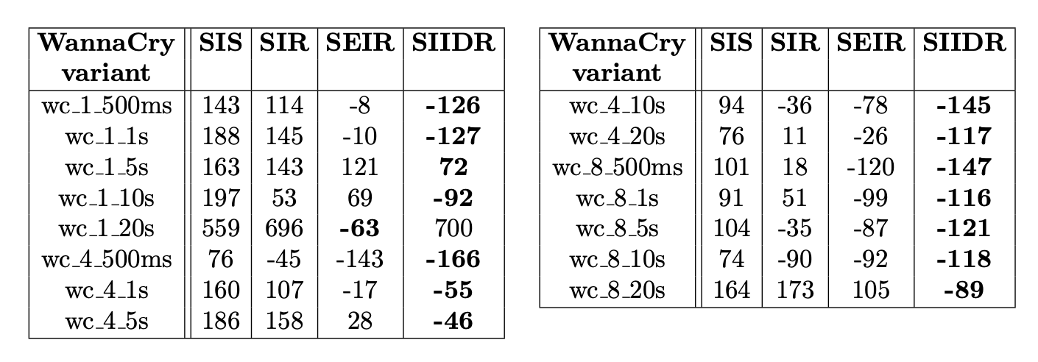
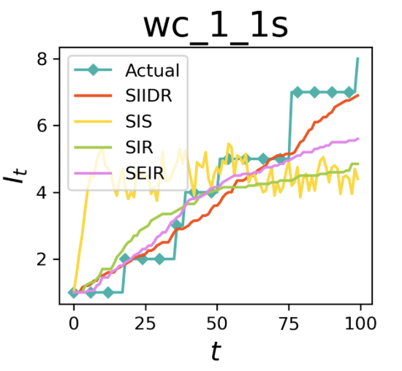
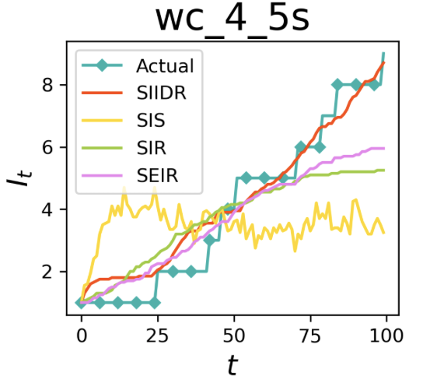
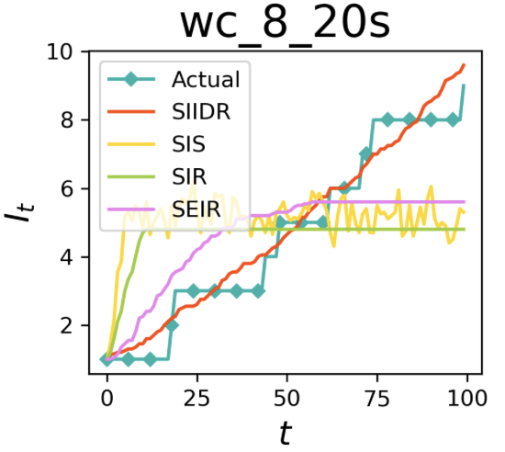
SPM Modeling
SIIDR outperforms other compartmental model based on Akaike Information Criterion (AIC) score. AIC = 2k - 2lnL, k -number of parameters, L - likelihood function.
The simulated numbers of infected nodes with SIIDR are the closest to the true WannaCry dynamics.
Lower is better
The reconstruction curves of infected nodes and the true WannaCry dynamics.
Notes:
The AIC is calculated based on the number of free parameters k and the maximum likelihood estimate of the model L. The first term introduces a penalty that increases with the number of parameters and thus discourages overfitting. The second term rewards the goodness of fit that is assessed by the likelihood function. For the likelihood function, we use the least squares estimation. The best model is the one with the lowest AIC.

Slide 15
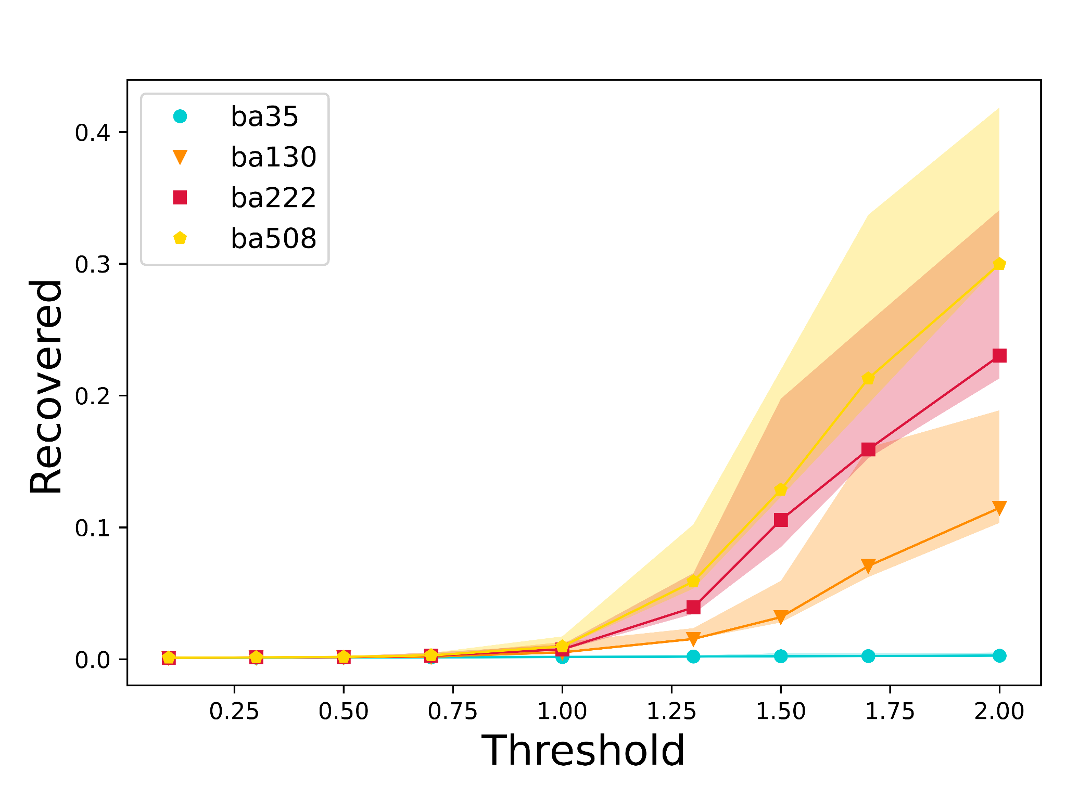
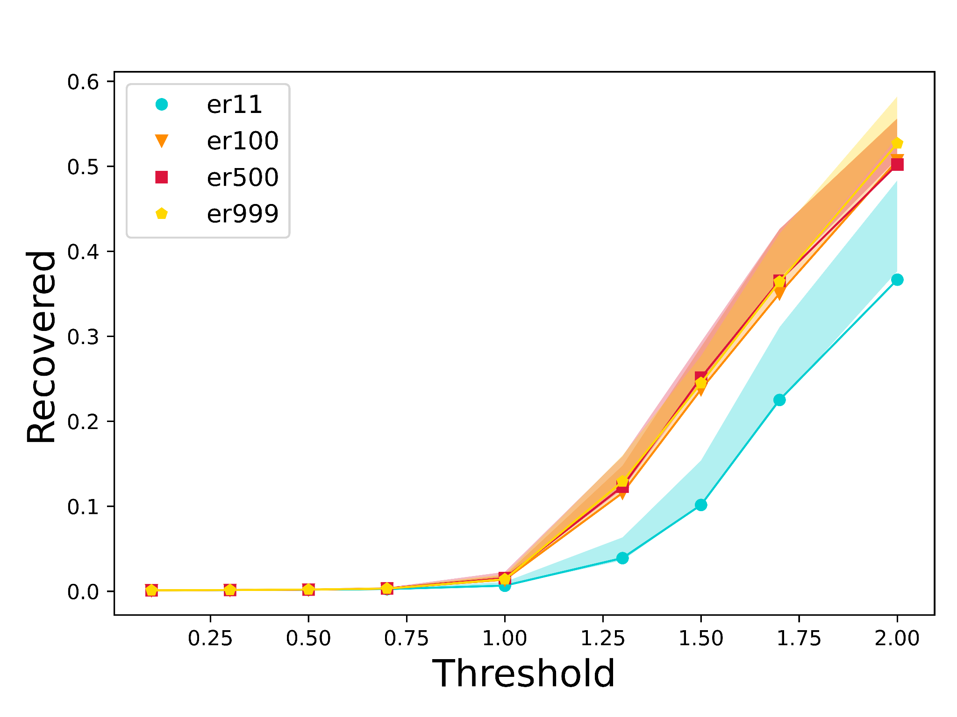
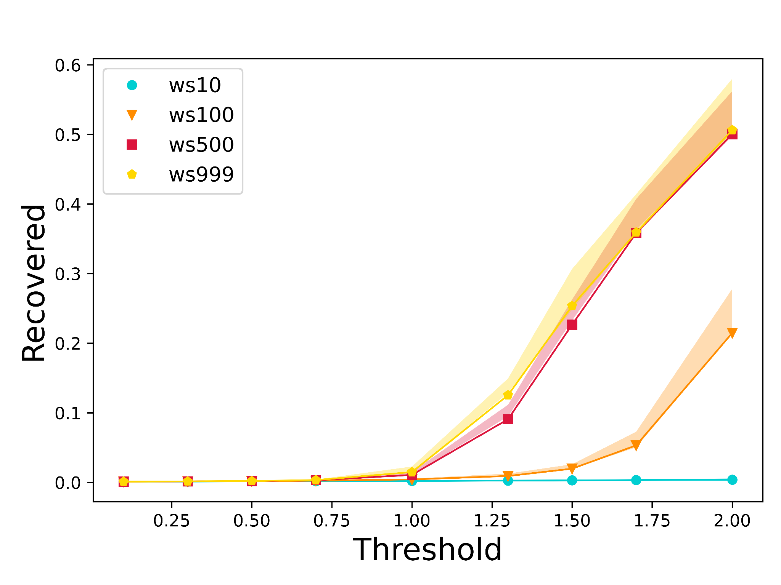
Threshold Evaluation
We plot the final number of recovered nodes in the different types of networks with respect to the threshold values s = .
For all types of graphs, the total fraction of recovered nodes is negligible for values of s ∼ 1.
Barabási-Albert (BA) graphs
Erdős-Rényi (ER) graphs
Watts-Strogatz (WS) graphs
Notes:
A graph of nodes is grown by attaching new nodes each with edges that are preferentially attached to existing nodes with high degree.
The model chooses each of the possible edges with probability p.
locally clustered network, while the randomly rewired links dramatically reduce the average path lengths
he Watts–Strogatz model is a random graph generation model that produces graphs with small-world properties, including short average path lengths and high clustering.

Slide 16
Limitations and Future Directions
Behavior of SPM can change in general in the future, so we will need another model to capture their characteristics, we do not look into continuous modeling in which networks are reconfigured, and attacks evolve over time.
We considered only internal traffic, because we have no global visibility on SPM propagation across different networks.
Measuring the data about other states rather than just the number of infected nodes as a function of time to characterize the system dynamics more extensively, may improve the SIIDR parameters estimation.

Slide 17
Conclusion
We introduced a new compartmental model SIIDR that captures the behavior of self-propagating malware.
We showed that it fits real-world WannaCry traces much better than existing compartmental models such as SI, SIS, and SIR previously studied in the literature.
We analytically derived the conditions when SPM is expected to become an epidemic and discussed the stability of model's disease-free equilibrium points. We supported the theoretical results with the experimental evaluation.

Slide 18
Proactive Defense Strategies against SPM
Paper: “Cyber network resilience against self-propagating malware attacks”, ESORICS 2022
link: https://link.springer.com/chapter/10.1007/978-3-031-17140-6_26

Slide 19
Motivation and Related Works
The continual evolution of attacks that avoid detection requires the design of innovative proactive measures that are able to counter a wide range of potential threats.
Building resilient infrastructures is budget-dependent, therefore rigorous assessment is needed to to establish real-world feasibility of the defenses.
System hardening methods attempt to reduce the “attack surface” under the limited budget.
Several previous works [Wong et al., 2014, Le et al., Tong et al, 2012] propose defense methodologies by manipulating the topology of the networks.
There is a need for additional work in several directions: previous works have performed comparisons and analysis using models that are less faithful than ours to the real-world behavior of WannaCry. In addition to improved analysis, we investigate new techniques for defense.

Slide 20
Threat Model
Network traffic has not been compromised, and, thus, the logged connections can be used to derive an accurate graph representation of the network communication topology.
The attacker has no knowledge about the defense.
We preserve the functionality of the network by only enhancing the security of most critical parts of the networks and reconfiguring the communication, not physically disconnecting or removing machines in the network.

Slide 21
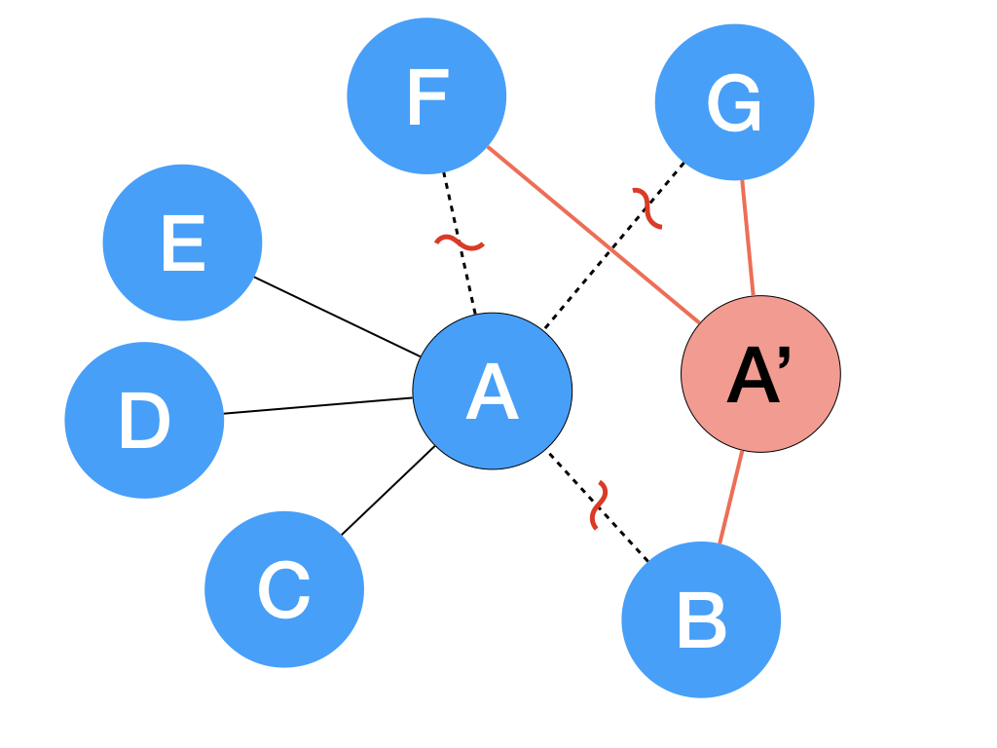
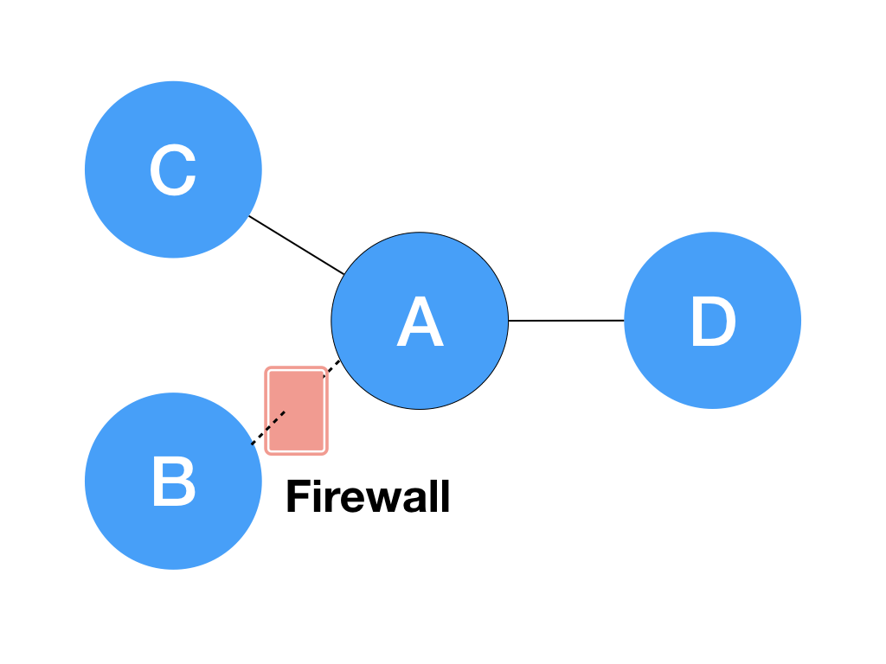
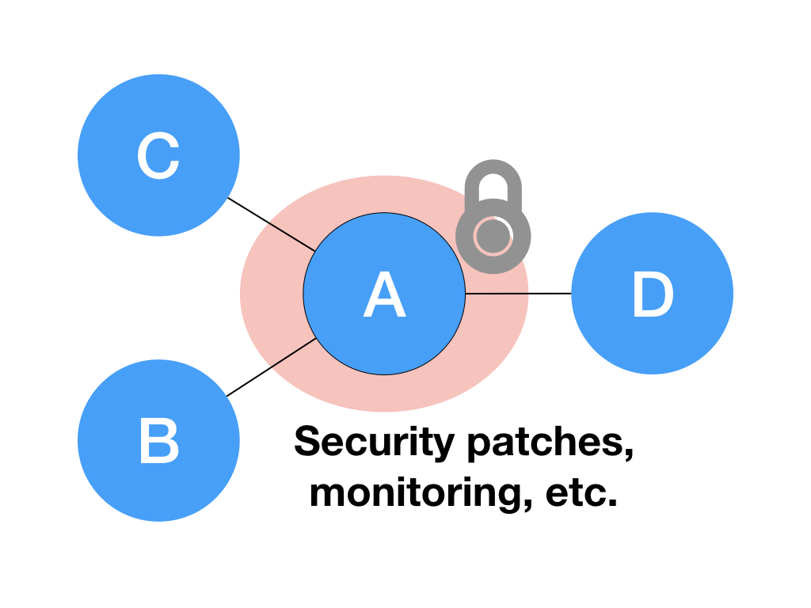
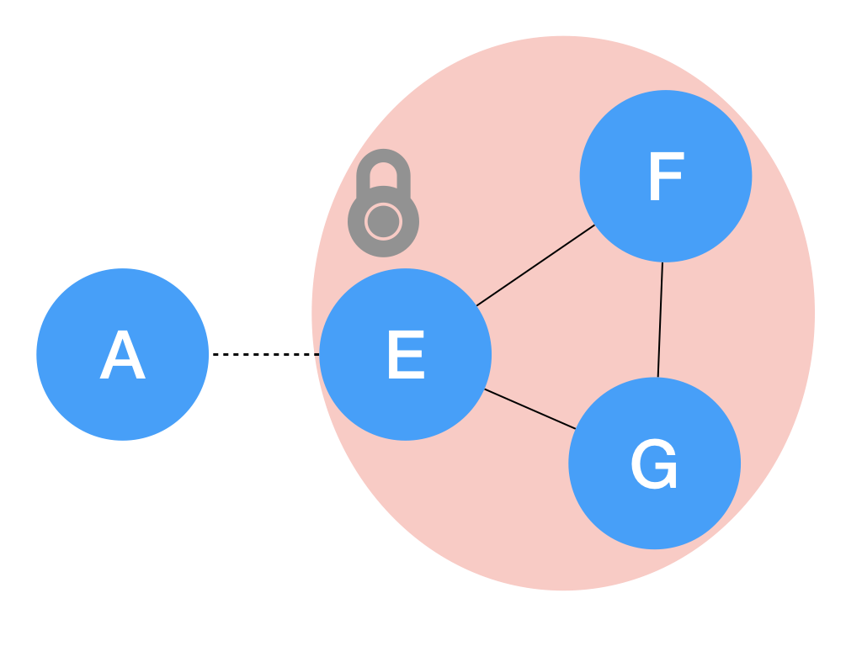
Defense Methodology
Defense Strategy | Graph Representation | Algorithms | Cybersecurity Measures
Node Splitting |  | NodeSplit | Adding new machines (physical/virtual), traffic routing
Edge Monitoring |  | RandE, MET | Firewalls, blocking flows
Node Monitoring |  | RandN, Degree, ENS, NB | System updates, Security patches
Isolation |  | CI-Edge, CI-Node NodeSplit + CI-Edge | Monitoring at community boundary
Notes:
In practice, the new node can be physical or virtual. A new physical node requires additional hardware, while a virtual node requires computational and memory resources on an existing server. Node splitting can be implemented in real networks by using existing traf- fic management frameworks. For instance, Microsoft Azure offers the Traffic Manager service [25], which allows routing of an application’s traffic to differ- ent endpoints. Its randomized traffic splitting procedure distributes an applica- tion’s traffic at random to multiple nodes and can be used directly to implement NodeSplit. Network traffic can also be reconfigured to different nodes using SDN- enabled policies

Slide 22
Defense Evaluation Measures
Metric | Description | Formula | Meaning
EigenDrop 𝚫𝛌 | The drop in the leading eigenvalue | 𝚫𝛌% = 100 x (𝛌 - 𝛌’) / 𝛌 | Path capacity reduction
Fragmentation 𝛔 | The fraction of nodes contained in the largest connected component | 𝛔 = Size(LCC) / Size(G’) | Attack surface reduction by containing the attack within smaller connected component
G - the original graph, G’- perturbed graph after applying defense
𝛌 - the leading eigenvalue of G, 𝛌’ - the leading eigenvalue of G’
LCC = the largest connected component
Size() = the number of nodes

Slide 23
Datasets and Graphs Characteristics
Anonymized network flow dataset spanning multiple days:
3.4 million nodes and 50 million links per day.
The Critical Watch Report of 2019 ¹ :
The majority of vulnerabilities found in TCP/UDP ports are linked to:
SSH (22/TCP),
HTTPS (443/TCP), and
HTTP (80/TCP).
We extract the communication graphs for 6 ports for one day.
Undirected and unweighted 3-core graph.
Port | Nodes | Edges | Standard Use
22 | 60,825 | 333,797 | SSH
80 | 287,156 | 1,833,568 | HTTP
443 | 620,096 | 4,437,255 | HTTPS
445 | 317,031 | 6,832,418 | SMB
139 | 1912 | 9532 | SMB over NetBIOS
383 | 7101 | 22,910 | HP data alarm manager
¹ https://www.newnettechnologies.com/study-finds-majority-of-port-vulnerabilities-are-found-in-three-ports.html
Notes:
We discover that our graphs have power-law degree distribution: while the bulk of the nodes have small degree, there is a smaller number of nodes with degrees much higher than the mean value.

Slide 24
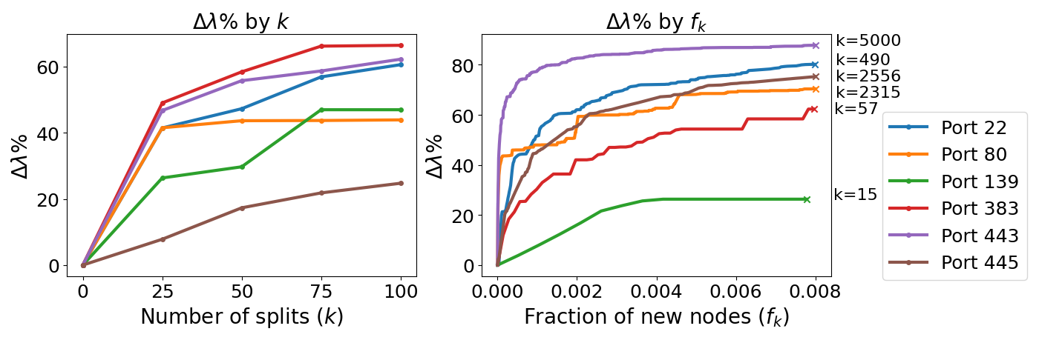
NodeSplit
NodeSplit is an iterative method that targets hubs (highly connected nodes) within a budget:
At each iteration, the current top-degree node is split randomly into two:
Half of the links remain with the existing node, and
Half of the links are moved to a newly created node.
Higher is better
A general increase trend in eigendrop is observed as the number of split nodes increases.
The size of the largest connected component is generally preserved.
Notes:
In practice, the new node can be physical or virtual. A new physical node requires additional hardware, while a virtual node requires computational and memory resources on an existing server. Virtual machines are usually a cheaper and more flexible alternative to adding physical servers to the network.
Node splitting can be implemented in real networks by using existing traf- fic management frameworks. For instance, Microsoft Azure offers the Traffic Manager service [25], which allows routing of an application’s traffic to differ- ent endpoints. Its randomized traffic splitting procedure distributes an applica- tion’s traffic at random to multiple nodes and can be used directly to implement NodeSplit. Network traffic can also be reconfigured to different nodes using SDN- enabled policies

Slide 25
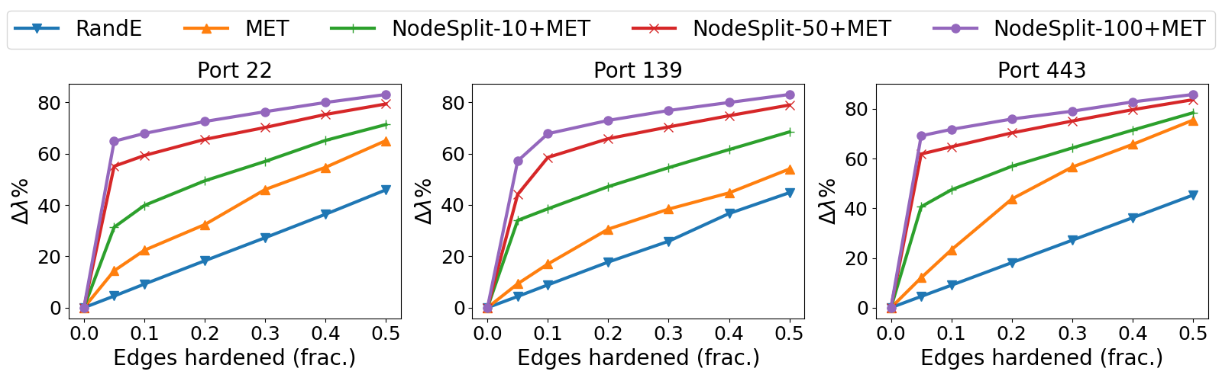
Edge Hardening
RandE (baseline) - monitoring random edges.
MET (Multiple Eigenvalues Tracking)[Le et. al., 2015]- utilizes eigenscores to estimate the effect of edge hardening on the leading eigenvalues.
NodeSplit-k + MET - hybrid strategy, k denotes a number of splits.
Higher is better
MET reduces the leading eigenvalue, and the hybrid strategy provides a significant additional drop.
MET is designed to work within a connected graph, fragmentation is generally preserved.
Notes:
Thus, minimizing 1 is crucial to minimizing dissemination in graphs.
eigenscore of an edge e from node i to node j is the product of the ith and jth elements of the left and right eigenvectors correspondingly.
MET deletes k edges by tracking multiple eigenvalues adaptively and by re-computing eigenscores when necessary.
We know that the largest eigenvalue of the graph’s adjacency matrix is a good indicator for its con- nectivity (a.k.a. path capacity). Thus, algorithms that are able to quickly reduce the largest eigenvalue of a graph often minimize dissemination on that graph. However, a problem arises when the differences between the largest eigenvalues of a graph are small. This problem, known as the small eigen-gap problem, occurs often in social graphs such as Facebook postings or instant messaging (IM) networks. We introduce a scalable algorithm called MET (short for Multi- ple Eigenvalues Tracking), which efficiently and effectively solves the small eigen-gap problem

Slide 26
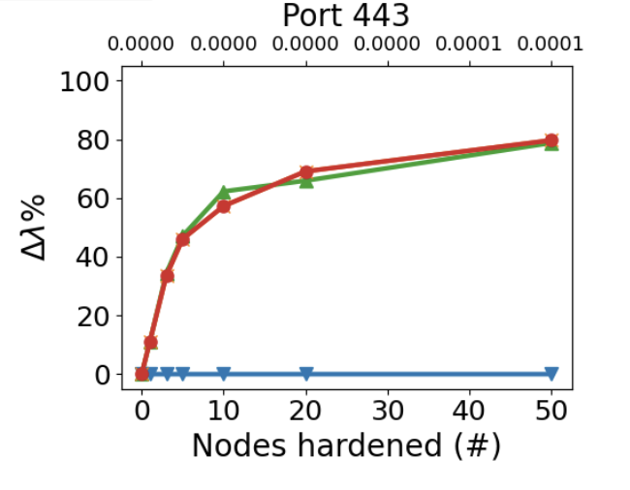
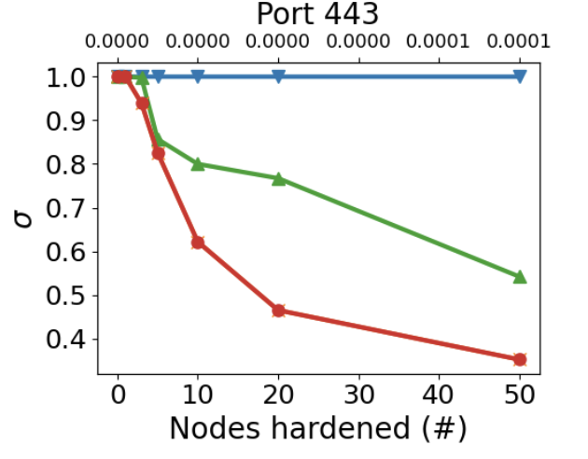

Node Hardening
RandN(baseline)- randomly monitoring nodes.
Degree - immunize the most connected nodes.
ENS (Effective Network Size) - immunize nodes with highest effective network size, ENS = n - 2t/n, n - total number of nodes in egocentric network excluding ego, t - number of ties in the egocentric network (excluding ties to the ego).
NB (Nonbacktracking Centralities)[Torres et.al., 2021] - protecting nodes which have the largest impact on the leading eigenvalue of the nonbacktracking matrix.
Higher is better
Lower is better
Degree, ENS and NB deliver very similar performance in terms of eigendrop, RandN is not successful.
Immunizing just 50 nodes with Degree/ENS is enough to break down the largest connected component, RandN has a low impact on connectivity.
Notes:
The more each node is disconnected from other primary contacts, the higher the effective size would be.
non-backtracking random walk on a graph is a random walk with the added condition that, on a given step, we are not allowed to return to the vertex visited on the previous step
The associated non-backtracking matrix is the unnormalized transition matrix of a random walker that does not trace backtracks
in network epidemiology, the reciprocal of the largest eigenvalue of the non-backtracking matrix is a good approximation for the epidemic threshold of certain network dynam ics.

Slide 27
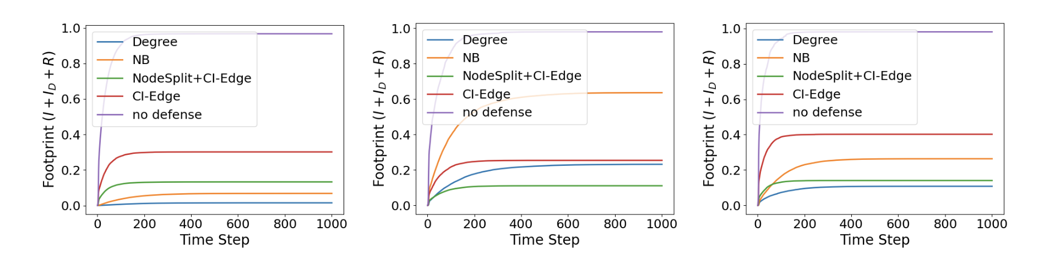
Evaluation of Attack Mitigation
Attack Mitigation - minimizing the number of Infected (I), Dormant (I_{D}), and Recovered (R) nodes.
Port 22
Port 80
Port 443
Lower is better
Node Hardening, Community Isolation and Hybrid strategies are the most successful at attack mitigation.
Infection rate is 97% before defense, and gets to 1% on port 22 after degree-based Node Hardening, and 11% on port 80 with hybrid Node Split+Community Isolation.

Slide 28
Limitations and Future Directions
We assume that the attacker has no knowledge about the defense.
We do not look at the multi-step game of attack and defense counterparts and how the methodology should change, but our results may serve as a basis for this direction.
Some defenses we proposed may be hard to implement in practice because it may appear expensive.

Slide 29
Conclusion
Cyber networks can be made resilient against SPM malware by modifying their topological structures.
The most effective defenses exploit the inherent hierarchy in networks to identify key super-spreaders and allocate security budgets to protect them.
Our newly proposed NodeSplit method increases the effectiveness of defenses by balancing the connections of hubs via reconfiguring communication.

Slide 30
Summary
Proposed new compartmental model SIIDR to capture SPM behavior.
Designed new strategies to proactively defend cybernetworks against SPM.

Slide 31
Thank you!
contact: chernikova.a@northeastern.edu

